Slide 1
Collaborative analyzing of key public documents
Like Budget Book, a Bill’s draft, a report, …
Any PDF document
Concept note
Nikhil VJ, Pune
Email: nikhil.js@gmail.com
Phone: 9665831250
Please see in Slideshow mode!

Slide 2
Mission Statement
We need a tool to collaboratively analyze important government documents which are published as PDFs.
Most basic requirement
We need a website that opens up a PDF into its individual pages, and lets people post their comments for every page.

Slide 3
How this platform can be used
Who would benefit from it
Collaboratively read, analyse, critique and demystify essential public interest documents like budget statements, policies, laws, reports etc
Do the same for parties’ manifestos, statements by leaders, companies etc
Group study of ebooks, reference material
Easily pinpoint and share the “devil in the details”
Bring out explanations in layman’s terms
Policy, budget analysts and advocates
Journalists
NGOs, civil rights movements
Clean politics movements
Citizens who need information, advice on complex issues
Students and educators
Collaborative online learning courses
Independent researchers looking for peer review

Slide 4
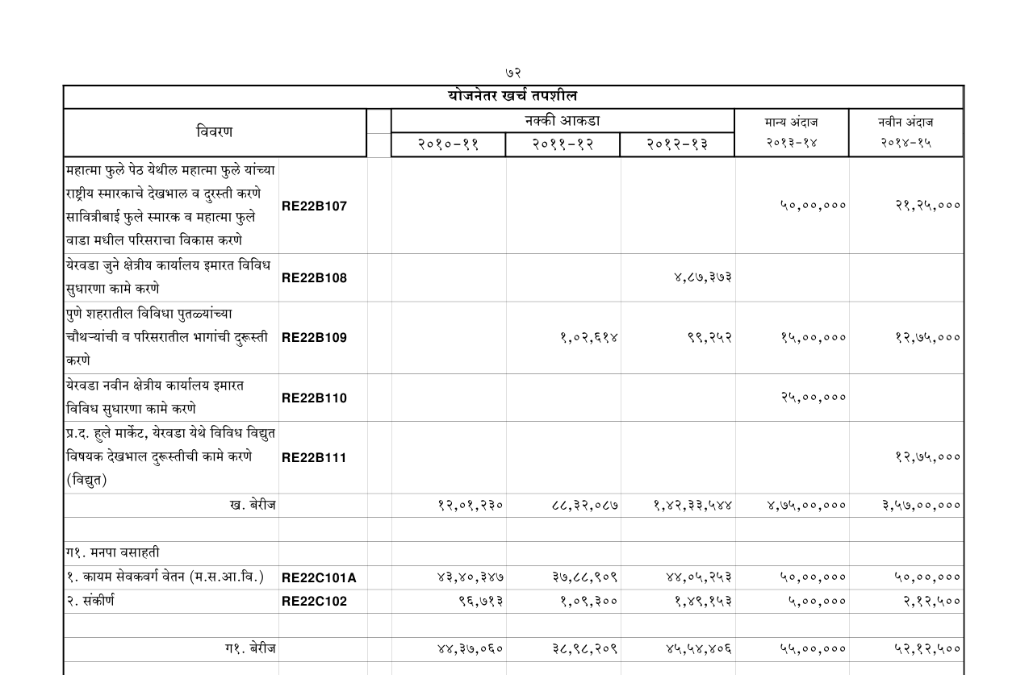

Logo,
click to go to Home page
[Title of document] (click to see doc’s details)
Other details :: uploader-profile :: Sign Up :: Sign In :: Log Out
<
56/121
>
Load adjoining page also
Bookmarks:
Start (1)
1. chap1 (3)
2. chap2 (13)
3. chap3 (21)
3.1. wseer (24)
3.2. dsfd (26)
4. chap4 (32)
5. chap5 (54)
6. chap6 (67)
7. chap7 (98)
8. chap8 (101)
9. chap9 (115)
End (121)
Suggest a bookmark
+
-
actual
size
zoom
to fit
Comments section
Go to next slide for explanations

Slide 5
Logo,
click to go to Home page
[Title of document] (click to see doc’s details)
Other details :: uploader-profile :: Sign Up :: Sign In :: Log Out
Can type in page number here to directly jump
<
56/121
>
Load adjoining page also
Checkbox, In case of table stretching across two adjoining pages
In this case, if ticked, pg57 is loaded on the right side of this page, user can zoom out / move the page to see it.
Page viewing area.
Mouse default behaviour: click and drag to move page around, like it’s done in Maps
Bookmarks:
Start (1)
1. chap1 (3)
2. chap2 (13)
3. chap3 (21)
3.1. wseer (24)
3.2. dsfd (26)
4. chap4 (32)
5. chap5 (54)
6. chap6 (67)
7. chap7 (98)
8. chap8 (101)
9. chap9 (115)
End (121)
Placemarks
Clicking on one darkens/highlights it, and brings up the comment: either popup, or highlights it in comments section below, or open in new window with reply trail. Can color-code based on comment type.
Highlight current page's or most recent bookmark
Suggest a bookmark
Scrollbars to move the page about
Scrollbar if more bookmarks
+
-
actual
size
zoom
to fit
Other users can give a simple text suggestion to add bookmark at current page; will be mesg’d to owner
Comments section
Keep viewing box height slightly smaller than full height of browser. User should be able to see the title of comments section, then scoll down for more.
Comments section explained in next slide

Slide 6
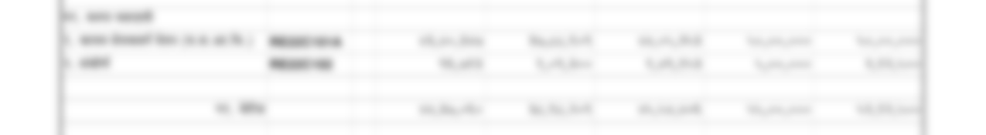
Scrolling down in the same window,
+
-
actual
size
zoom
to fit
Comments
Can Reply to each comment.
Up or down voting for each comment.
In QnA, assuming replies would be answers.
If this all seems too complex, just keep a simple comments feed like Disqus, and ensure that every page in the PDF gets its own separate comments feed.
When seeing document’s properties, “activity feed” displays in which all pages new comments have come
View by type :
All
QnA
Suggestions
Criticisms
Compliments
Other
Sort by:
Popularity
Date posted
Reverse Order
Add a comment
Type (dropdown list)
Post
Tip: for adding a comment to a specific point on the page, right-click on the point to add one there itself.
Go to next slide…

Slide 7
Just demonstrating the adding-placemark feature
Add a new:
Question
Suggestion
Criticism
Compliment
Other
Title
x
Text
Post
Right-clicking at a point on the page viewer opens up a custom context menu
+
-
actual
size
zoom
to fit
Comments section
THE END! Thanks for taking a look. So let’s make this!

